Slide 1
Azure Purview explortion

Slide 2
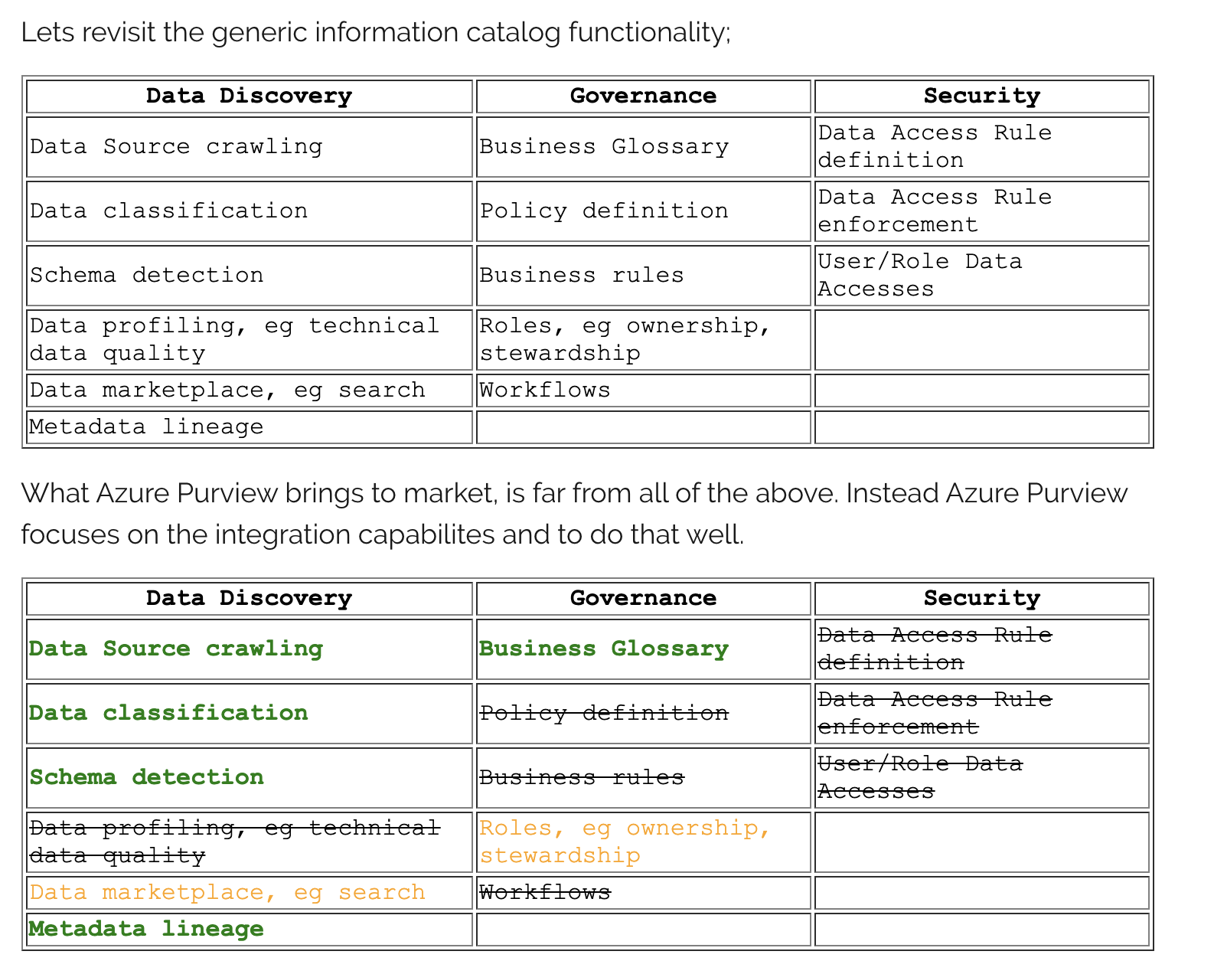
Other Data governance vs Purview

Slide 3
Ways to do Data Discovery
Search based I am looking for a table with data on “cancel rates” Where is the table? What does it contain? Has the analysis I want to perform already been done? | 2. Lineage based If this event is down, what datasets are going to be impacted? Upstream/downstream lineage Incidents, SLA misses, Data quality | 3. Network based I want to check what tables manager uses Ownership information Bookmarking Usage through query logs
Data Discovery for All Users
New Users : Need to know Where to start ? Power Users : Share knowledge with the Organization

Slide 4
Data Discovery Challenges:
Discovery challenges for data consumers
Traditionally, discovering enterprise data sources has been an organic process based on communal knowledge. For companies that want the most value from their information assets, this approach presents many challenges:
Because there's no central location to register data sources, users might be unaware of a data source unless they come into contact with it as part of another process.
Unless users know the location of a data source, they can't connect to the data by using a client application. Data-consumption experiences require users to know the connection string or path.
The intended use of the data is hidden to users unless they know the location of a data source's documentation. Data sources and documentation might live in several places and be consumed through different kinds of experiences.
If users have questions about an information asset, they must locate the expert or team that's responsible for the data and engage them offline. There's no explicit connection between data and the experts that have perspectives on its use.
Unless users understand the process for requesting access to the data source, discovering the data source and its documentation won't help them access the data.

Slide 5
Data Discovery Challenges
Discovery challenges for data producers
Although data consumers face the previously mentioned challenges, users who are responsible for producing and maintaining information assets face challenges of their own:
Annotating data sources with descriptive metadata is often a lost effort. Client applications typically ignore descriptions that are stored in the data source.
Creating documentation for data sources can be difficult and it's an ongoing responsibility to keep documentation in sync with data sources. Users might not trust documentation that's perceived as being out of date.
Creating and maintaining documentation for data sources is complex and time-consuming. Making that documentation readily available to everyone who uses the data source can be even more so.
Restricting access to data sources and ensuring that data consumers know how to request access is an ongoing challenge.
When such challenges are combined, they present a significant barrier for companies that want to encourage and promote the use and understanding of enterprise data.

Slide 6
Purview Advantages:
Azure Purview is designed to address the issues mentioned in the previous sections and to help enterprises get the most value from their existing information assets. The catalog makes data sources easily discoverable and understandable by the users who manage the data.

